Slide 1

Confirmatory Factor Analysis: Hierarchical & Nested Models
Lynette H. Bikos, PhD, ABPP

Slide 2
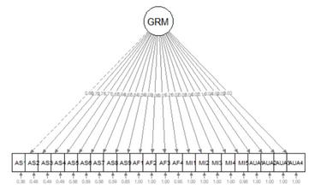
Unidimensional, single-order, factor structure
Each item is influenced by a single common factor and a term that includes systematic and random error.
Note that there is only one systematic source of variance for each item, and it is from a single source.
Interpretation: the latent variable directly causes the responses on the individual items
Satisfactory global fit supports use of a total scale score (but not subscale scores)

Slide 3
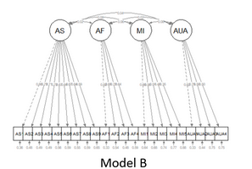
Correlated factors model
AKA: “correlated traits” model.
The larger construct is separated into distinct-yet-correlated elements.
The variance of each item is assumed to be a weighted linear function of two or more common factors.
Interpretation: Item level responses are directly caused by each of the correlated factors (which are related to each other).
Satisfactory global fit supports the use of subscale scores (but not a total scale score)

Slide 4
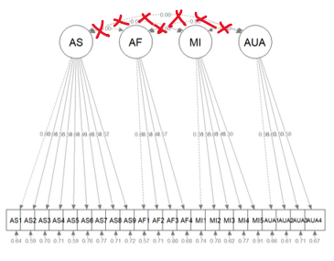

Uncorrelated factors model
Each item is uniquely influenced by a single common factor and a term that includes systematic and random error.
Although these factors live together in a common space, they do not covary (i.e., they are not related).
Satisfactory global fit supports the use of subscale scores.

Slide 5
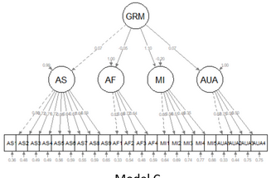
Second order factor structure
Factors are related because they share a common cause -- the second order factor explains why three or more traits are correlated.
Supports use of total scale score and subscale scores.
Interpretation: Item-level responses are caused directly by the first order factors, and indirectly from the larger factor (like a mediation).

Slide 6
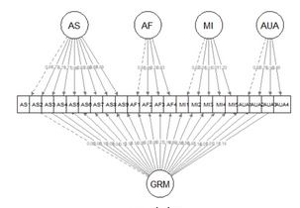
Bifactor model
This general factor (g, bottom row) reflects what is common among the items and represents the individual differences on the target dimension that a researcher is most interested in.
Group factors (top row) are now specified as orthogonal. The group factors represent common factors measured by the items that explain item response variation not accounted for by the general factor
Interpretation: item-level responses are influenced by g and the grouping factors…separately (not mediated like the second-order structure).

Slide 7
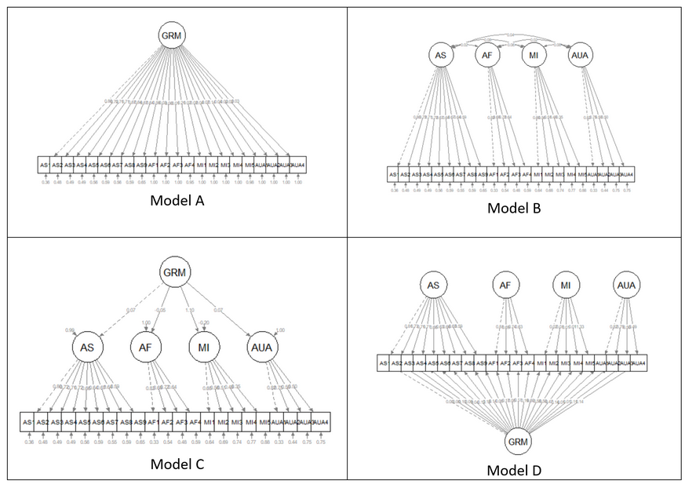
The factor structure family
Unidimensional:
Supports use of a total scale score
Will likely have the poorest global fit
Correlated factors:
Supports subscale scores.
Will have one of the best global fits (and perhaps identical to second order)
Second order:
Supports use of a total scale and subscale scores.
Will have one of the best global fits (and perhaps identical to correlated factors)
Bifactor :
Supports use of total and subscale scores.
May have the best fits (and perhaps identical to second order)
Factor loadings for subscales may deteriorate
Uncorrelated factors (not shown):
Supports use of subscale scores.
Global fit will be lower than correlated factors.
A significant limitation is that in a subscale/psychometric situation, we would expect factors to be correlated to why would we do it?

Slide 8
Model identification
Models that you can run
Just-identified
Identical number of parameters and observations
Zero degrees of freedom
Solve this pair of equations
a + b = 6, when
2a + b – 10
There is ONE solution: a = 4, b = 2
Over-identified
More observations than free parameters
Positive degrees of freedom
Solve this set of equations
a + b = 6, when
2a + b = 10, and
3a + b = 12
There is no single solution that satisfies all 3 formulas, but there is a way to find a unique solution. By imposing the least squares criterion we could say, “Find values of a and b that yield total scores such that the sum of squared differences between the observations (6, 10, 12) and these total scores are as small as possible and also unique:
a = 3.00, b = 3.33, solutions are 6.44, 9.33, 12.33
The solution is not perfect, but it facilitates model testing
Models you cannot run
Underidentified
More free parameters than observations
Negative degrees of freedom
Solve this equation
a + b = 6
There are an infinite number of solutions (this is a problem and the model will fail to converge)

Slide 9

Model identification in CFA
Rule | Reminder
A unidimensional (single) factor needs at least three indicators.
Factor models with more than one factor (e.g., correlated traits) need at least two or more indicators per factor (3-5 is recommended).
Second order factors need three first-order factors.
There are ways to break all of these rules (the trick is to constrain parameters so that degrees of freedom are saved…but you have to have a good reason to do it).

Slide 10
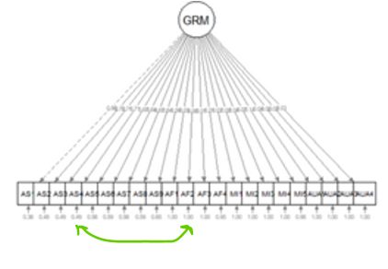
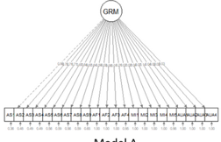
Two models are nested (hierarchical) if one is a proper subset of the other
Nesting model
Nested model
Has the most parameters freed to covary
Has more paths/covariances drawn on it (more “sticks in the nest”
Has fewer degrees of freedom
(almost always) Will have the better fit
Example1: correlated factors model
Example 2: “freeing a parameter” (i.e., drawing a path) suggested by a modification indices
Has fewer parameters freed to covary (i.e., more parameters fixed to be zero)
Has fewer paths/covariances drawn on it (fewer “sticks in the nest”)
Has more degrees of freedom
(almost always) will have the worse fit
Example 1: uncorrelated factors model
Example 2: fixing two parameters to be uncorrelated (e.g., resisting the temptation to free the parameter/draw that path).

Slide 11
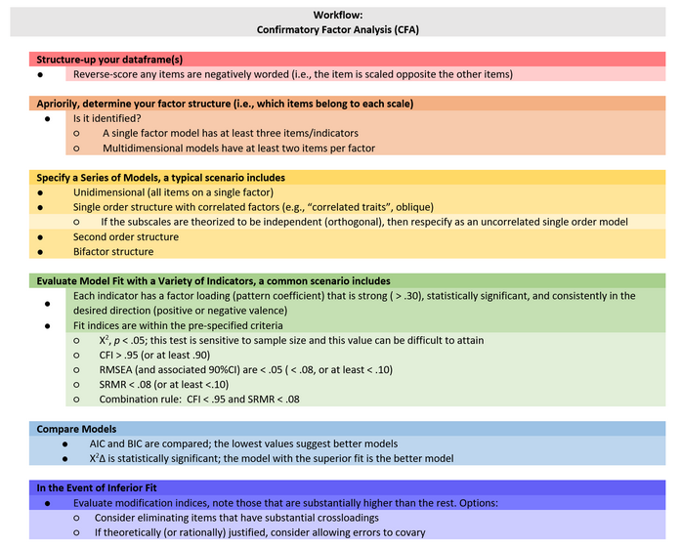

Slide 12
A key to today’s lavaan code
Code | Interpretation | Example
=~ | “is defined by” Used to create the equations for the factors/latent variables | GRMS ~ AF1 + AF2 + AF3 Where GRMS is the latent variable/factor AF1, AF2, AF3 are items
~~ | When two different variables are on either side, it means covariance (correlation) When the same variable is on either side, it means variance | AF ~~ AS (freed to covary) AF ~~ AF (variance of AF)
‘ | The “map” of equations should have a name (e.g., “MyMod”) and be contained within single quotation marks. | MyMod <- ‘ f1 =~ y1 + y2 + y3 f2 =~ y4 + y5 + y6 ‘
Behind the scenes | lavaan fixes the factor loading of the first indicator of an LV to 1 lavaan automatically correlates all factors in a CFA model; if you want these to be uncorrelated you must add additional code

